Slide 1
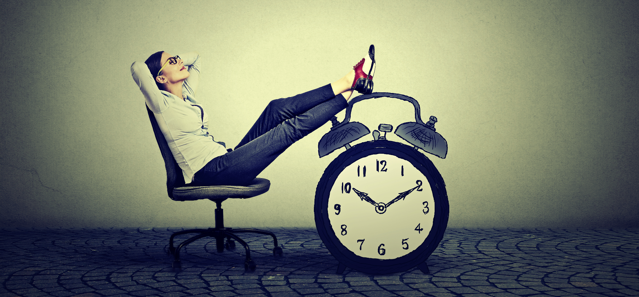
Team 3 presents: Team 5
Adobe Stock Images
Hannah Cussen, Nils Forstall, Bahvya Shah, Simran Tandon

Slide 2
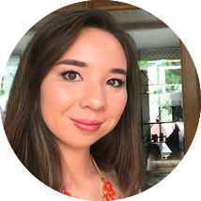
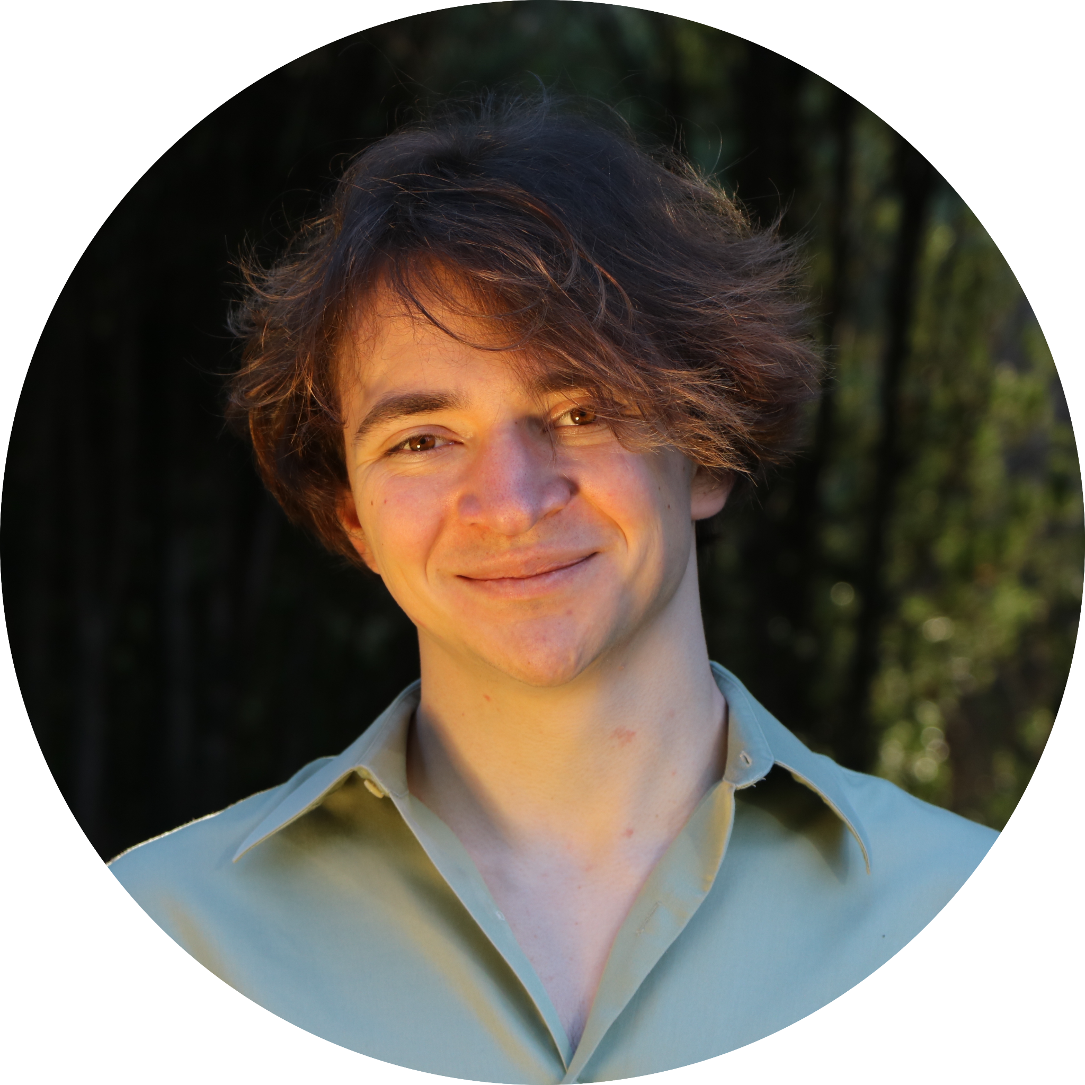
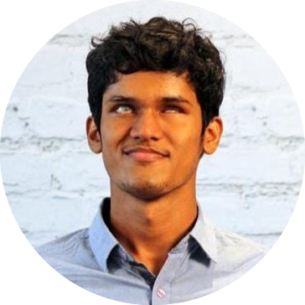
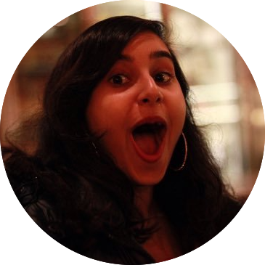
Team Members
Hannah Cussen
Nils Forstall
Bahvya Shah
Simran Tandon
Notes:
Here are our team members

Slide 3
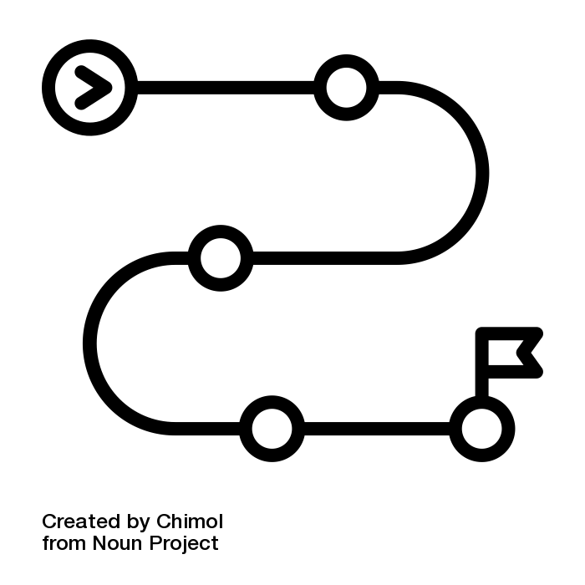
Roadmap
Problem domain
Needfinding methodology
Overview of interviews
  Methodology
  Results
  Empathy map
Insights
Key learnings
What’s next?

Slide 4
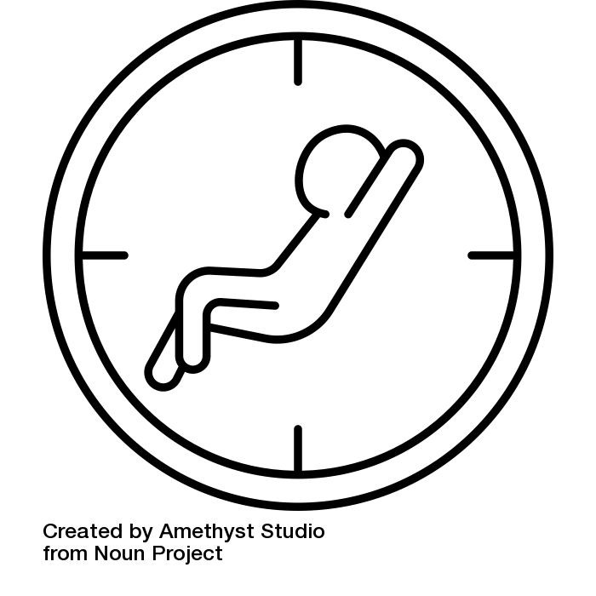
Problem Domain
How do people feel about their freetime?
“Protecting” freetime
Balancing freetime and work
Are people satisfied with their freetime?
Is freetime actually free?

Slide 5
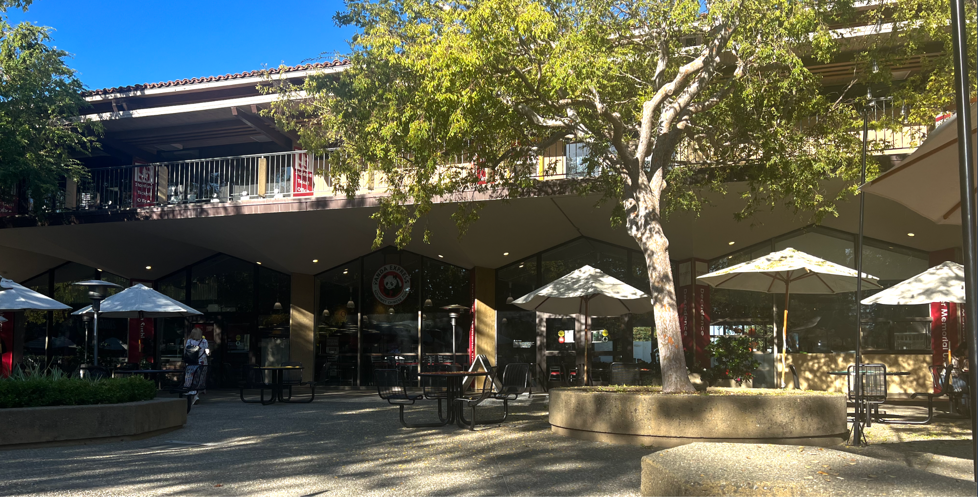
Needfinding Methodology
Who is enjoying free time at Tressider?
On vacation, touring Stanford
Just getting off of work
On a break from work/volunteering
Limitations: people without free time!

Slide 6
We interviewed...
Name | Ayesha | Jane | Erica | Jee
Description | A member of a guerilla marketing team who likes to travel and is questioning her relationship to social media | A working mother visiting Stanford who primarily values education and work in her time | A Jehovah’s witness minister who enjoys spreading the word of God and is constantly checking her email | A Korean father visiting Stanford who spends most of the day at work but whose favorite part of the day is coming home to his family.
Interviewer | Nils | Simran | Simran | Bahvya
Notetaker | Simran | Hannah | Nils | Hannah
Notes:
These people all recruited

Slide 7
And asked them…
Can you walk me through a day where you had a lot of free time? A day where you didn't?
What did your schedule look like yesterday?
What does prioritization in your life look like?
How do you feel technology has affected your time?
What's the first thing you do when you finish working?

Slide 8


Interview Results - Jee
Do you spend your free time with yourself or other people?
"I consider my family members as myself"

Slide 9
Interview Results - Jane
“In China we always think we have to do something meaningful. work & study is meaningful…but if you spend time with someone - time is most precious, more than money”
  Cultural shift
The first priority is work–“clearing your work is important.”
The second priority is studying with her daughter.

Slide 10
Interview Results - Erica

Slide 11
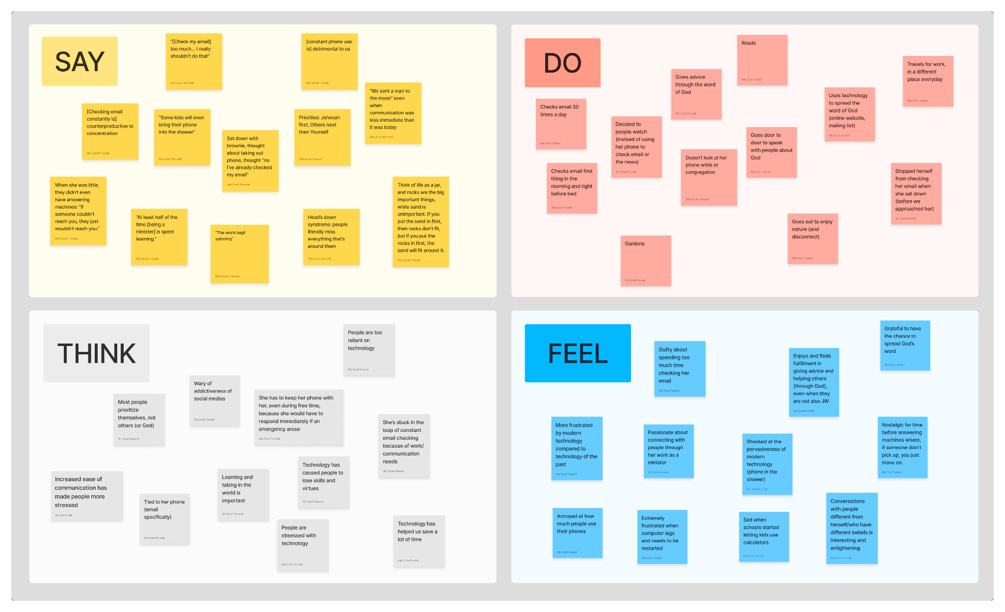
Empathy Map

Slide 12
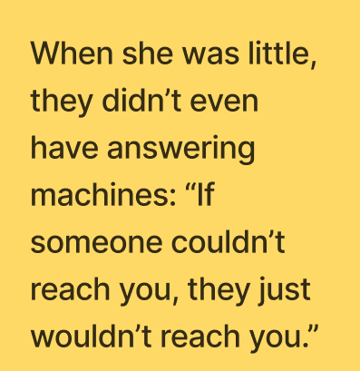
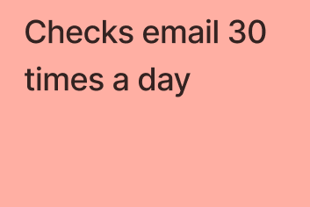
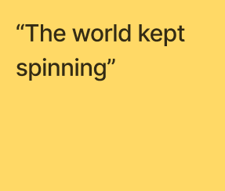
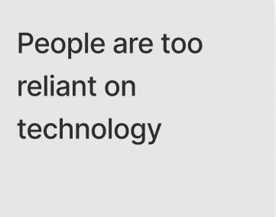
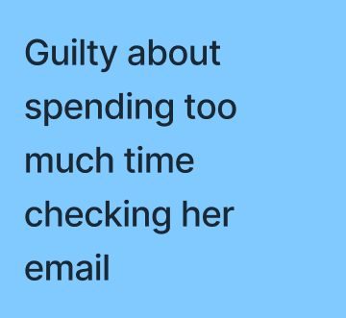
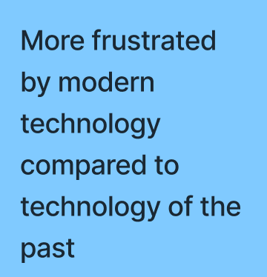
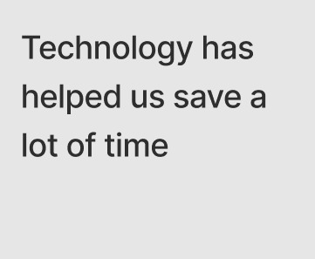
Empathy Map

Slide 13
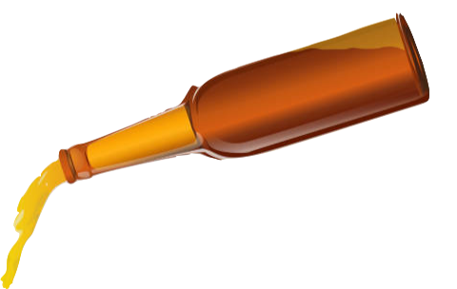
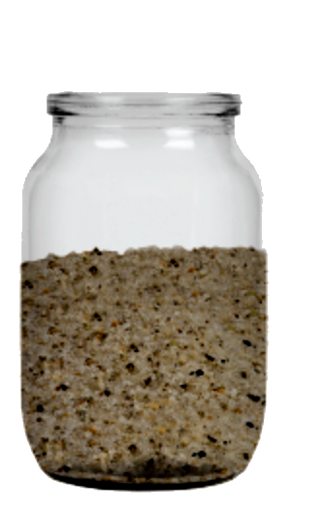
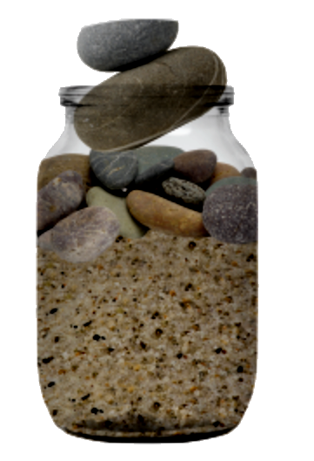
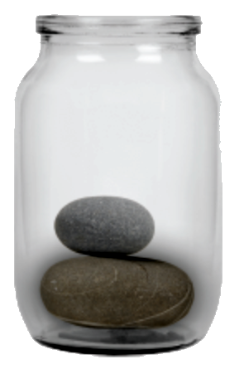
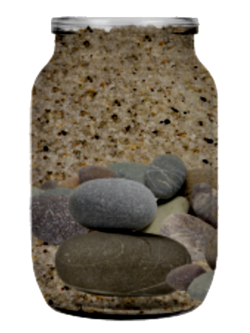
Interview Results - Erica
Prioritization as rocks, sand, and jars
vs.
A Smart Bear, iStock

Slide 14
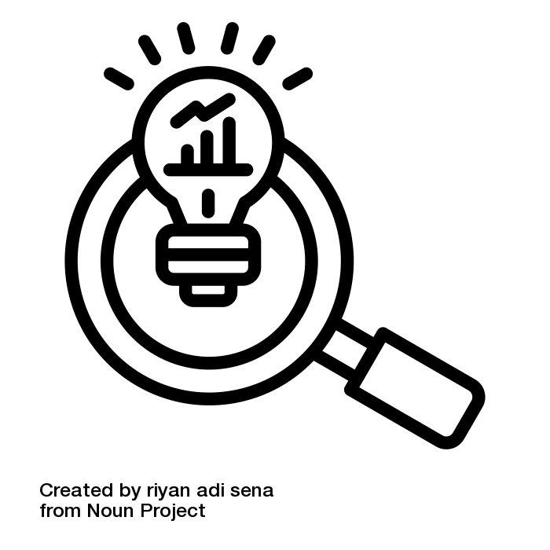
Insights
Instantaneous communication makes it hard to have unburdened freetime
  Alters expectations of productivity
"Free time" can still be full of activities, and isn’t always reserved for oneself
  For Jee, free time is more about time with family
People have strong ideas of what is most important to them, but don’t always act on them

Slide 15
Key Learnings
Many different conceptions of freetime
People most often discuss how they prioritize tasks within their free time
Prioritization involves more than productivity

Slide 16
What’s Next?
Pivot from "protecting your free time" to "time prioritization and values" (especially outside of work)
Interview people with less free time
Dive deeper into the effects of instant communication

